Slide 1

PRINCIPLES OF BIG DATA MANAGEMENT
Analysis on various diseases all over world based on Twitter data
Presented By
Moulika Chadalavada
Sampatha Gattu
Lakshmi Nikitha Kona
Prathyusha P

Slide 2
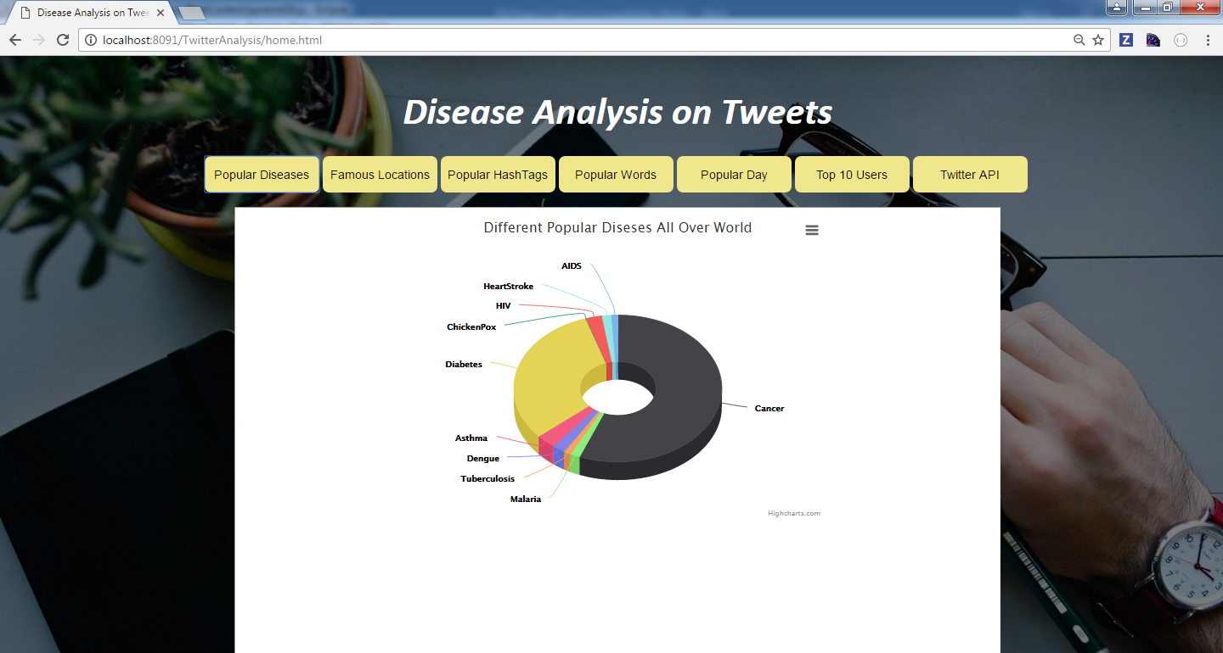
Popular Diseases all over the world
DataFrame data = sc.sql("SELECT text from tweets where text like '%heartattack%‘ or text like '%cancer%‘ or text like '%hiv%‘ or text like '%aids%‘ or text LIKE '%diabetes%‘ or text like '%tuberculosis%' or text like '%braintumour%' or text like '%malaria%‘ or text like '%dengue%‘ or text like '%asthma%' or text like '%chickenpox%'"); // Java 7 and earlier: count the words JavaPairRDD<String, Integer> reducedCounts = counts.reduceByKey( new Function2<Integer, Integer, Integer>(){ public Integer call(Integer x, Integer y){ return x + y; } } );

Slide 3
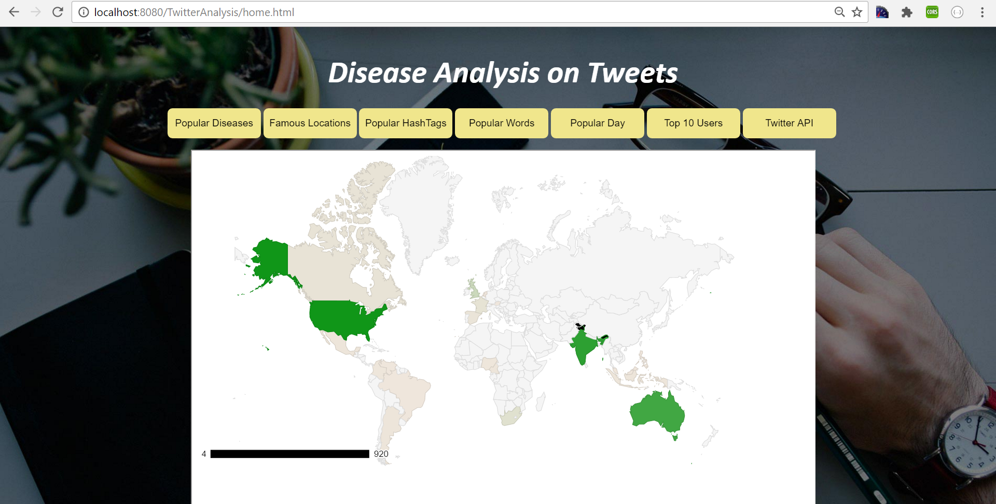
Countries that tweeted more on Diseases
case "3" => val stateWiseCnt = sqlContext.sql(""" SELECT user.location,text from tweets where text is not null""".stripMargin) stateWiseCnt.createOrReplaceTempView("stateWiseDataCnt") val stateWiseDataCnt = sqlContext.sql("select US_State, count(text) as State_Tweet_Count from stateWiseDataCnt where US_State is not null and text is not null group by US_State,text order by count(text) desc") println("Which US State Tweeted More On Which Disease")
stateWiseDataCnt.show();

Slide 4
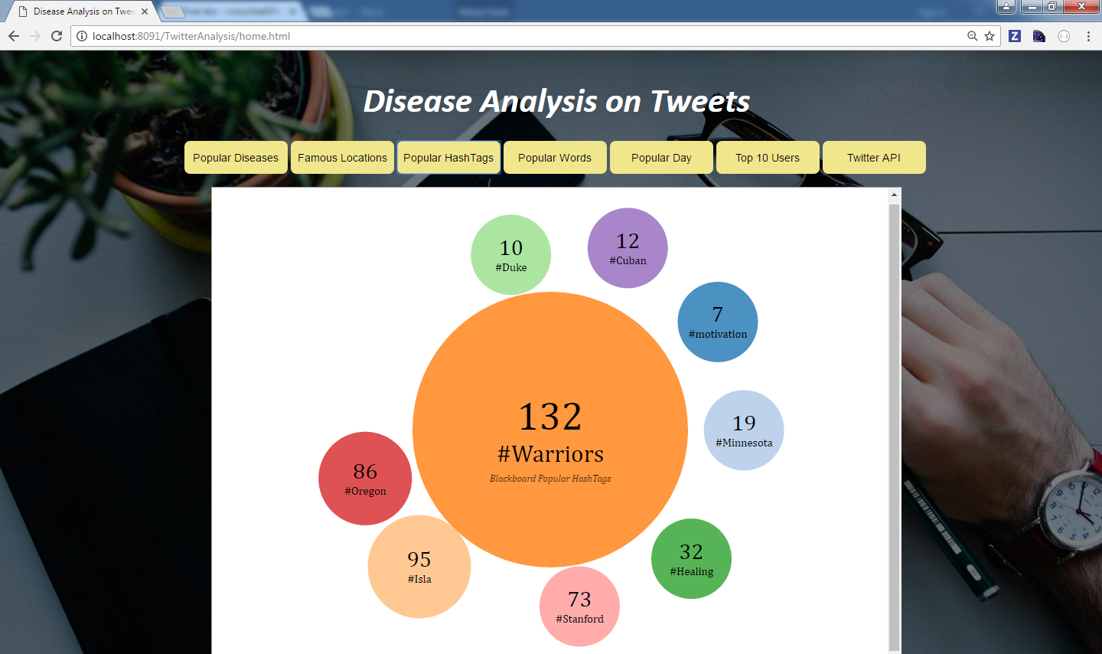
Popular HashTags
case "5" => val hashtag = sqlContext.read.json( "C:\\Users\\nikky\\Downloads\\HashtagsTopics.txt") hashtag.createOrReplaceTempView("hashtag")
val query = sqlContext.sql( "SELECT t.text as Text,d.name as HashTag from tweets t JOIN hashtag d ON t.text like CONCAT('%', d.name, '%')")
println("Same Hash Tags from Tweets and Blackboard Tweets")
query.show()

Slide 5
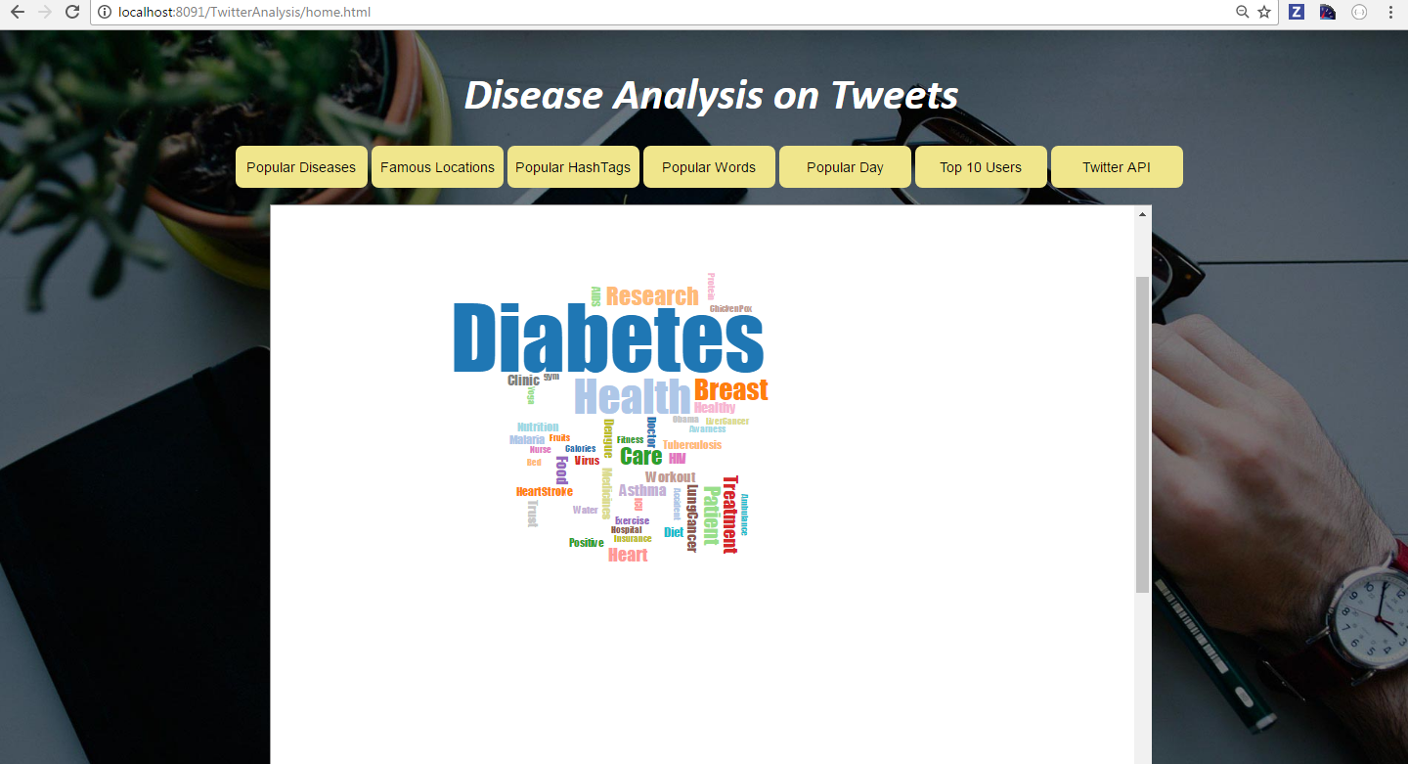
Most Popular Tweeted Words on Diseases
DataFrame data = sc.sql("select text from tweets where text is not null");
JavaRDD<String> words = data.toJavaRDD().flatMap(new FlatMapFunction<Row, String>() {
public Iterable<String> call(Row row) throws Exception { String s = ""; if((row.getString(0).contains("food")||row.getString(0).contains("Food"))) { s = s + " " + "Food"; }
if(row.getString(0).contains("health") || row.getString(0).contains("Health")) s = s + " " + "Health";

Slide 6
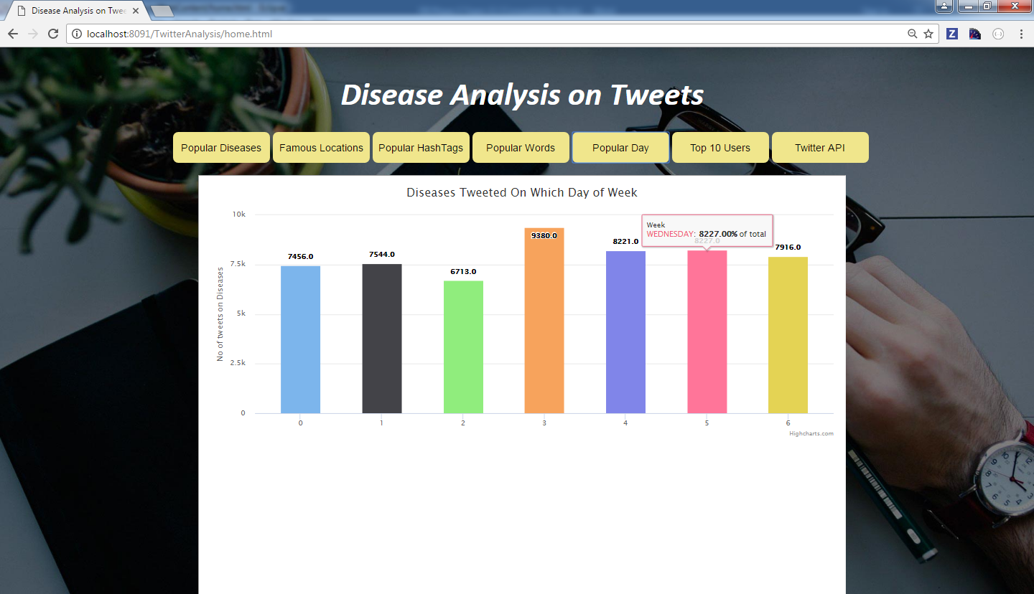
Popular day of week tweeted more on diseases
DataFrame data1 = sc.sql("SELECT day from texts where (day LIKE '%Mon%'" + "or day LIKE '%Tue%'" + "or day LIKE '%Wed%'" + "or day LIKE '%Thu%'" + "or day LIKE '%Fri%'" + "or day LIKE '%Sat%'" + "or day LIKE '%Sun%')" + "and day is not null");

Slide 7
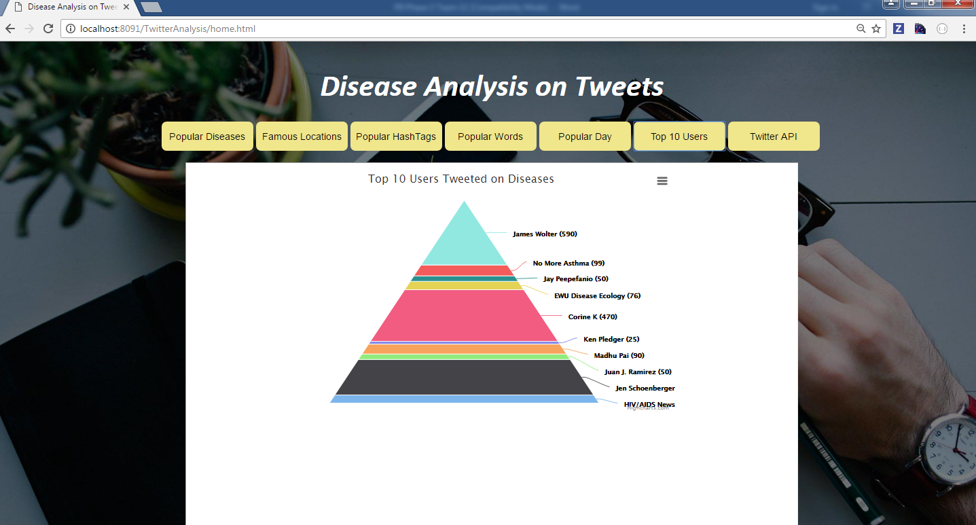
Top 10 Users Tweeted on Diseases
case "2" => val r1 = sqlContext.sql("SELECT user.name as UserName,count(*) as count FROM disCat2 WHERE UserName is not null group by UserName order by count desc limit 10") r1.show()

Slide 8
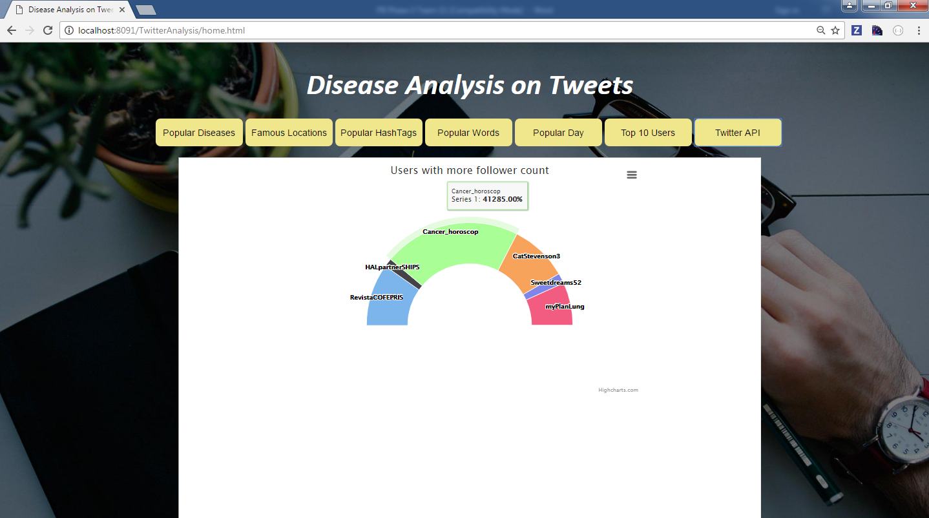
Users with more follower count
case "2" => val r1 = sqlContext.sql("SELECT user.name as UserName,count(*) as count FROM disCat2 WHERE UserName is not null group by UserName order by count desc limit 10") r1.show()

Slide 9


